Slide 1
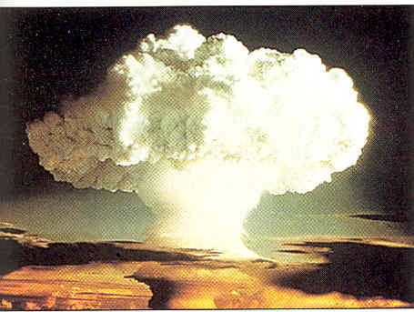
Nuclear Energy
Energy from disintegrating atomic nuclei
Tremendous potential
About 17% of the energy in the world comes from nuclear power plants.

Slide 2
History of Nuclear Energy Development
The first controlled fission of an atom occurred in 1938 in Germany
The US was the first to develop an atomic bomb
In 1945, the US military dropped bombs on the Japanese cities of Hiroshima and Nagasaki
During the 50 years following WWII, the two major super powers conducted secret projects related to the building and testing bombs
A legacy of the military research is that a great deal of soil, water, and air are contaminated with radioactive material (Hanford, Savannah River sites).

Slide 3
History - Continued
After WWII many people began to see the potential for using nuclear energy for peaceful purposes. The world’s first electricity generating reactor was constructed in the US in 1951.
In December 1953, President Dwight D. Eisenhower, in his “Atoms for Peace” speech said,
“Nuclear reactors will produce electricity so cheaply that it will not be necessary to meter it. The user will pay an annual fee and use as much electricity as they want. Atoms will provide a safe, clean, and dependable source of electricity.”
The Russians built their first plant in 1954.

Slide 4
Nuclear reactor construction in the US has been on hold for a long time now as concerns over the safety of the reactors and the problem of nuclear waste storage have not been solved.
Nuclear power industry experts believe that the American public will begin to favor nuclear reactors as a source of electricity because they do not produce carbon dioxide during the production of electricity.
The Bush energy plan has provisions for constructing nuclear reactors.
Energy Policy Act – 1.45 billion plus for the cogeneration part – Subtitle D – Nuclear Energy 4.6 billion

Slide 5
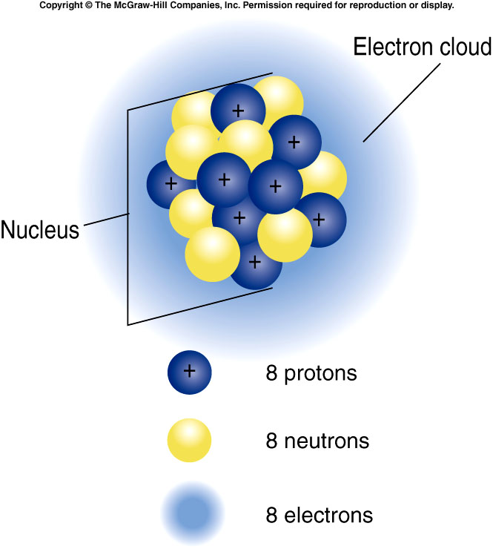
Atomic structure – Atoms are fundamental subunits of matter. Matter is anything that takes up space and has mass. Air, water, trees, cement, and gold are examples of matter.
H₂O
All atoms have a central region know as the nucleus, which is composed of two kinds of relatively heavy particles: positively charged particles called protons and uncharged particles called neutrons. Surrounding the nucleus is a cloud of relatively light weight, fast moving, negatively charged particles called electrons. The atoms of each element differ in the number of protons, neutrons, and electrons present.
Figure 4.2 diagram of oxygen

Slide 6
Isotopes
All atoms of the same element have the same number of protons and electrons but the number of neutrons may differ.
Atoms of the same element that differ in the number of neutrons are called isotopes.
Since the positively charged protons in the nucleus repel one another energy is needed to hold the protons and neutrons together.
However, some isotopes of some atoms are radioactive, that is the nucleus of these atoms are unstable and decompose. Neutrons, electrons, and protons are released during this decomposition releasing a great deal of energy. Half-life… ½ of radioactive material to decompose

Slide 7
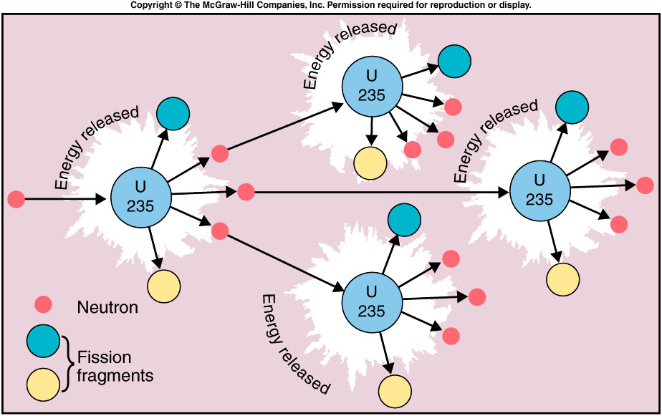
Only certain kinds of atoms are suitable for the development of a nuclear chain reaction. The two materials most commonly used are uranium-235 and plutonium-239.

Slide 8
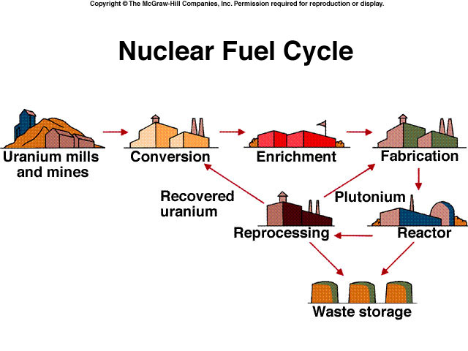
To appreciate the consequences of using nuclear fuels to generate energy it is important to recognize the nuclear fuel cycle. Mining produces low grade uranium ore. The ore contains 0.2 % uranium by weight. After it is mined, the ore goes through a milling process. It is crushed and treated with a solvent to concentrate the uranium. Milling produces yellow-cake, a material containing 70-90% uranium oxide.

Slide 9
Naturally occurring uranium ore contains about 99.3% nonfissionable U-238 and only 0.7% fissionable U235 (the U235 is the uranium isotope needed in nuclear reactors). This concentration of U-235 is not high enough for most types of reactors, so the amount of U-235 must be increased by enrichment. Since the masses of the isotopes U-235 and U-238 vary only slightly, enrichment is a difficult and expensive process. However, enrichment increases the U-235 content from 0.7% to 3%.
Fuel fabrication converts the enriched material into a powder, which is then compacted into pellets about the size of a pencil eraser. These pellets are sealed in metal rods about 4 meters (13.2 feet) in length, which are then loaded into the reactor (of course the enrichment and fabrication generally do not occur at the reactor so these enriched rods have to be transported to the site of the reactors).

Slide 10
As fission occurs, the concentration of U-235 decreases. After about three years a fuel rod does not have enough radioactive material to sustain a chain reaction so the rods must be replaced by new ones. The spent rods are still very radioactive, containing about 1 percent of the U-235 and 1 percent plutonium. These rods are the major source of radioactive waste material.
You may have heard about the US and nuclear inspectors looking for aluminum rods in Iraq. Some countries with nuclear reactors try, through centrifugation, to extract the plutonium so it can be used in nuclear weapons. This is a current concern with North Korea. The US has known that the North Koreans had used rods in a pool at one of their plants. Apparently, during the recent visit by the group of citizens they were shown the pool but it contained no spent rods.

Slide 11
Nuclear Reactors
A nuclear reactor is a device that permits a controlled fission chain reaction. In the reactor, neutrons are used to cause a controlled fission of heavy atoms such as Uranium 235 (U-235). U-235 is a uranium isotope used to fuel nuclear fission reactors.

Slide 12
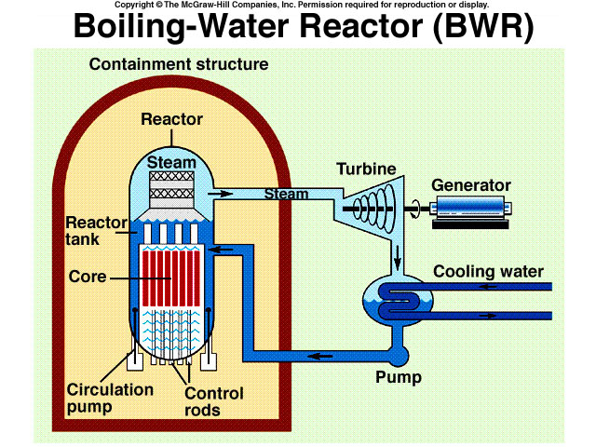
The heat generated by the fission of or uranium releases energy that heats water to produce steam to turn turbines to generate electricity.
Cooling Tower
In addition to fuel rods containing uranium, reactors contain control rods of cadmium, boron, graphite, or some other non-fissionable material used to control the rate fission by absorbing neutrons. Lowering the rods decreases the rate of reaction.

Slide 13
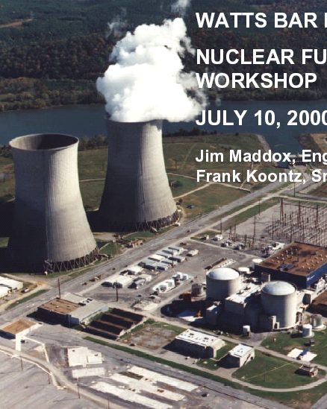
Natural Draft
Hyperbolic Cooling
Towers
Containment Structure

Slide 14
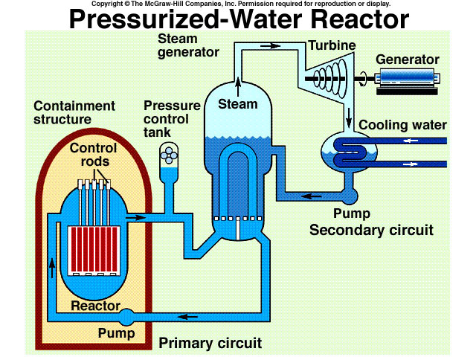
The light water reactors (LWR) make up 90% of the reactors operating today, use ordinary water as the moderator and as the coolant. The BWR and PWR are light water reactors. In a BWR (20% of reactors in the world). Steam is formed within the reactor and transferred directly to the turbine.
Emergency core
cooling system
The steam must be treated and the generating building must be shielded. In the PWR (70% of reactors in the world) the water is kept under high pressure so that steam is not formed in the reactor. Such an arrangement reduces the risk of radiation in the steam but adds to the cost of construction by requiring a secondary loop for the steam generator.

Slide 15
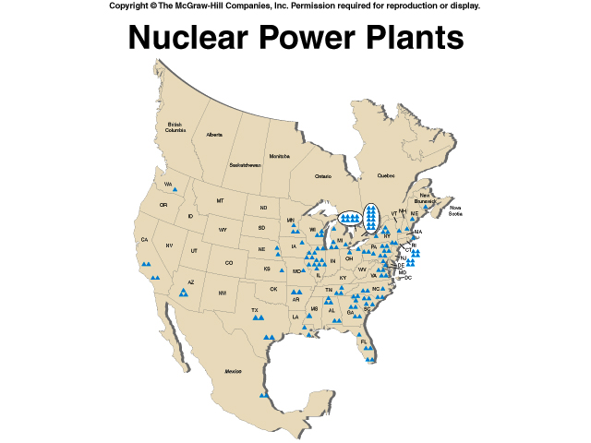
Comanche Peak

Slide 16
The future of nuclear power is uncertain. The International Atomic Energy Agency (IAEA) forecasts that the total installed nuclear capacity in 2015 will be little more than that in 2000. In 2002, Germany announced that it would close all 19 of its nuclear power plants by 2021 making it the largest industrialized nation willing to forgo the technology. Most planned reactors are in the Asian region. Both South Korea and Japan have plans for new plants (South Korea, 12 reactors, Japan 15 reactors). China with four operating reactors, has begun the next phase of its nuclear power program. Construction has started on seven reactors.

Slide 17
Most nuclear power plants originally had a nominal life span of 40 years, but engineering assessments of many plants over the last decade have established that many can operate longer. In the US most reactors now have confirmed life spans of 40 to 60 years. In Japan, 40 to 70 years. In the US the first two reactors have been granted license renewals, which extends their operating lives to 60 years. A few tidbits:
No new plants commissioned in US since 1974
17% of electricity from nuclear power plants
103 plants currently operating at 64 sites in 31 states
nuclear power plants ran 92% of the time in 2002
average age is 22 years, programmed age 40 years extended to 60
Spent fuel at Texas’s plants stored in water filled vats
Since 1993, 175 metric tons of uranium from weapons have been transformed into fuel for nuclear power plants.

Slide 18
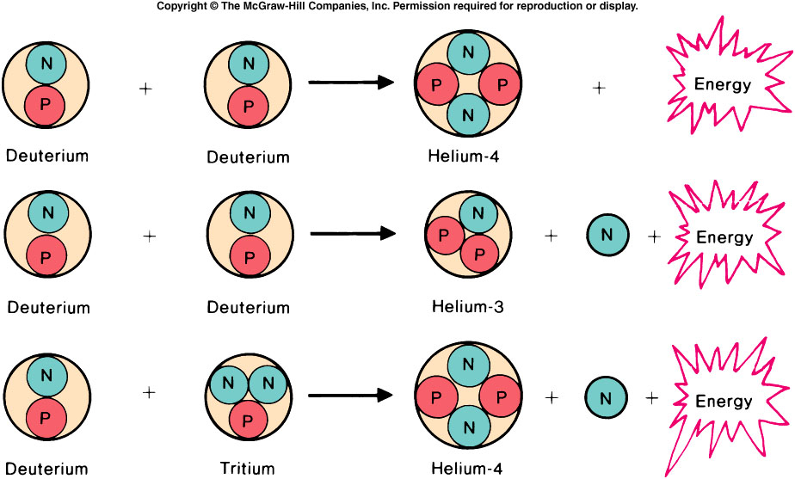
Nuclear Fusion
The energy that would be released by combining the deuterium in one cubic meter of ocean water would be greater than that contained in all of the world’s entire fossil fuels. Even though in theory fusion promises to furnish large amounts of energy, technical difficulties appear to prevent its commercial use in the near future. Even the governments of nuclear nations are budgeting only modest amounts of money for fusion research. And, as with nuclear fission and the breeder reactor, economic costs and fear of accidents may continue to delay the development of fusion reactors.

Slide 19
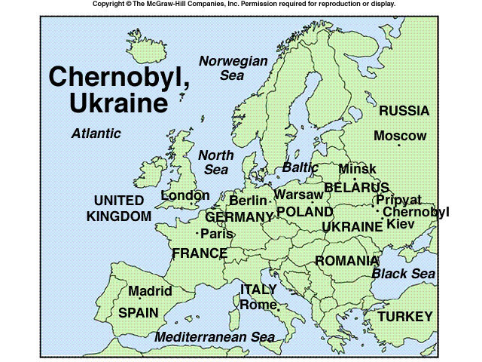
Chernobyl is a small city in Ukraine near the border with Belarus, north of Kiev. At 1 A.M. on April 25, 1986, at Chernobyl Nuclear Power Station-4, a test was begun to measure the amount of electricity that a still spinning turbine would produce if the steam were shut off. This was important
information because the emergency core cooling system required energy for its operation and the coasting turbine could provide some of that energy until another source became available. But the test was delayed because of a demand for electricity, and a new shift of workers came on duty.

Slide 20
The operators failed to program the computer to maintain power at 700 megawatts, and output dropped to 30 megawatts. This presented an immediate need to rapidly increase the power, and many of the control rods were withdrawn. Meanwhile, an inert gas (xenon) had accumulated on the fuel rods. The gas absorbed the neutrons and slowed the rate of power increase. In an attempt to obtain more power, operators withdrew all the control rods. This was a second safety violation.
At 1 AM on April 26, the operators shut off most emergency warning signals and turned on all eight pumps to provide adequate cooling for the reactor following the completion of the test. Just as final stages of the test were beginning, a signal indicated an excessive reaction in the reactor. In spite of the warning, the operators blocked the automatic reactor shut down and began the test.
As the test continued, the power output of the reactor rose beyond its normal level and continued to rise. The operators activated the emergency system designed to put the control rods back into the reactor and stop the fission.

Slide 21

“There is absolutely no cause for alarm at the nuclear plant!”
Tribune Media Services, Inc.

Slide 22
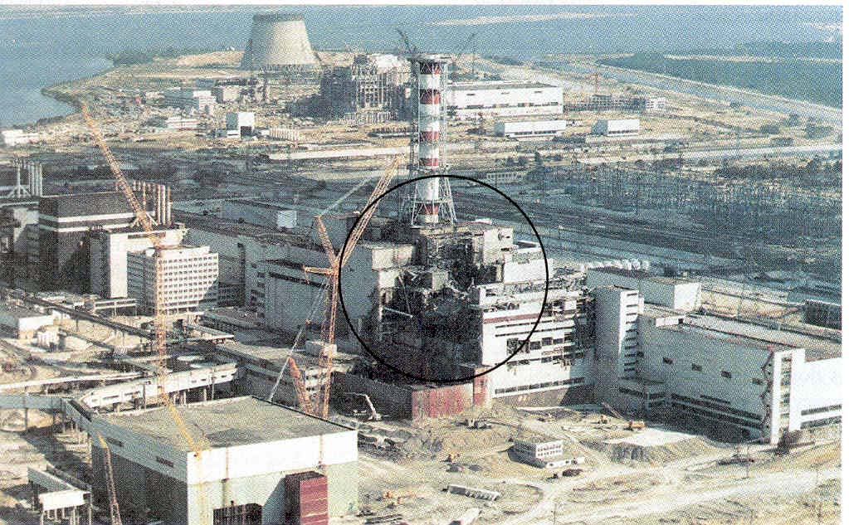
The core had already deformed, and the rods would not fit properly: the reaction could not be stopped. In 4.5 seconds the energy level of the reactor increased 2000 times. The fuel rods ruptured, the cooling water turned into steam, and a steam explosion occurred. The lack of cooling water allowed the reactor to explode. The explosion blew the 1102 ton concrete roof off the reactor and the reactor caught on fire.
In less than 10 seconds, Chernobyl became the scene of the world’s worst nuclear accident. It took 10 days to bring the runaway reaction under control. By November, the damaged reactor was entombed in a hastily built concrete covering that may have critical flaws. A 2nd containment is planned.

Slide 23
The immediate consequences were 31 fatalities, 500 persons hospitalized, including 237 with acute radiation sickness; and 116,000 people were evacuated. More than a year after the disaster at Chernobyl, the decontamination of 27 cities and villages was considered finished. That does not mean they were safe just that all practical measures had been completed. Some areas were simply abandoned. The largest city to be affected was Pripyat which had a population of 50,000 and was only 4 kilometers from the reactor. A new town was built to accommodate those displaced by the accident and Pripyat remains a ghost town. Seventeen years after the accident some scientists believe the worst is yet to come. Compared to the general public (control) the rates of some noncancer diseases, endocrine disorders, and stroke for instance appears to be rising disproportionately among the roughly 600,000 “liquidators” who cleaned up the heaviest contamination in the plant’s vicinity. Whether people who live in the shadow of Chernobyl remain at risk is an intensely debated question now.

Slide 24
One impact of Chernobyl is that it deepened public concern about the safety of nuclear reactors. Even before Chernobyl, between 1980 and 1986, the governments of Australia, Denmark, Greece, Luxembourg, and New Zealand had officially adopted a “no nuclear” policy. Since 1980, 10 countries have cancelled nuclear plant orders or mothballed plants under construction. Argentina canceled 4 plants, Brazil 8, Mexico 18, and the US, 54. There have been no orders for new plants in the US since 1974. Sweden, Austria, Germany, and the Phillipines have decided to phase out and dismantle their nuclear power plants.
Decommissioning Costs
Decommissioning a a fossil fuel plant is relatively easy a wrecking ball is about all that is required. Nuclear power plants are not demolished they are decommissioned. Decommissioning involves removing the fuel, cleaning the surfaces, and permanently preventing people from coming in contact with the contaminated buildings and equipment.

